Slide 1
ICT 2205 Coursework Part 2
Group Members: Ong Chen Yi 1902189 Koh Kai Quan 1902115 Zulfadli Bin Johari 1902147 Chua An Rong Aaron 1902146 Koh Jie Ming Benjamin 1902181

Slide 2
Content
Background
Design
What is Cryptochat?
Protocol / Schemes
Potential Threats
Known Attacks
Security Goals
Detailed Program Flow & Demo
Notes:
Content page for long report (Skipped for short presentation)

Slide 3

Background
Communication between people, especially regarding to sensitive information, is always a major concern. Thus, users are seeking for a secure with low overhead cost method for a private communication channel that is essential when dealing with sensitive information (E.g, Business Communication). Due to many possible form of attacks on the raise over the internet. For example, the possible risk of a Man in the middle (MITM) attack that could steal/alter data
What is Cryptochat?
Decentralized End to End Encrypted (E2EE) Web Chat Application
Private and Secure Communication Between 2 Users
Confidentiality, Integrity, Authenticity

Slide 4
Potential Threats

Slide 5
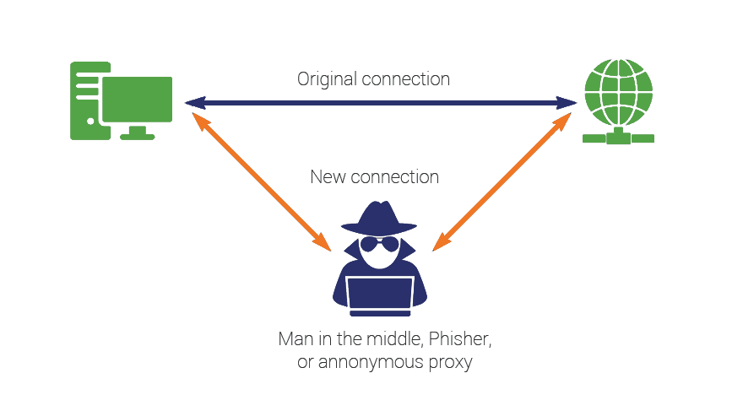
MitM Cyber Attack
Man-in-the-middle (MitM)
Cyber attack technique used to intercept and steal credentials or personal information, compromise communications, alter or corrupt sensitive data.
Different forms of techniques:
IP Address Spoofing
DNS Spoofing
SSL Hijacking/Stripping
Access Point Sniffers
Commonly occurs when an unwanted entity intercepts a communication, before it reaches its intended destination, between two client or system.
Notes:
Determine what potential threats available + in real world situation

Slide 6
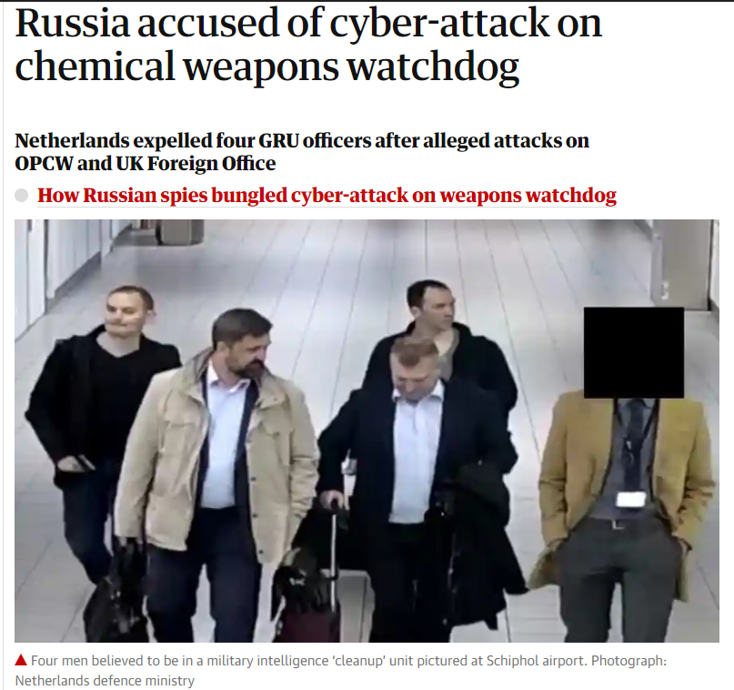
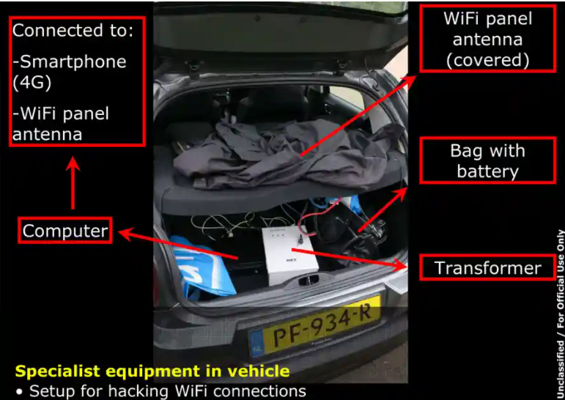
MitM Cyber Attack (Example)
Cozy Bear (APT 29)
In 2018, a Russian hacker group that attempt to hack the “Organization for the Prohibition of Chemical Weapons” in Holland, Netherlands
Employ MitM techniques to gain access into the network via a MitM rogue access point sniffer to steal sensitive credentials
Notes:
Determine what potential threats available + in real world situation

Slide 7
Data Privacy & Protection
Data Privacy & Protection
The large usage of Messaging and Chat Applications (Apps) have introduced large amounts of data being transmitted over the internet
Information collected can be categorized into:
User Provided Information
Automatically Collected Information
Third-Party Information
Lack of proper framework and standard to protect privacy of data leads to abuse and failure to comply to regulatory obligations
Notes:
Determine what potential threats available + in real world situation

Slide 8
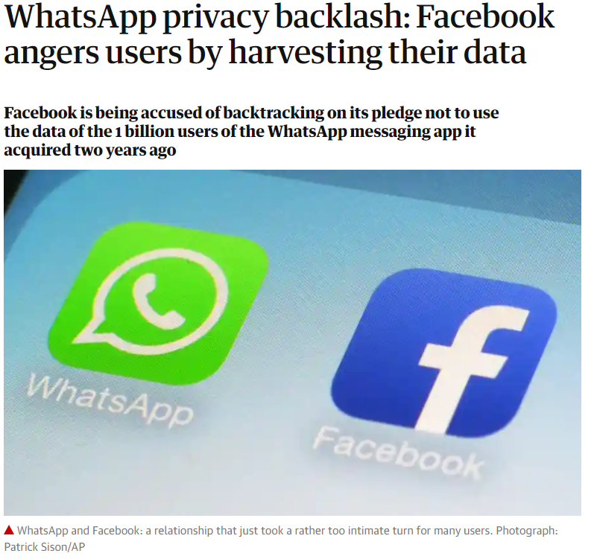
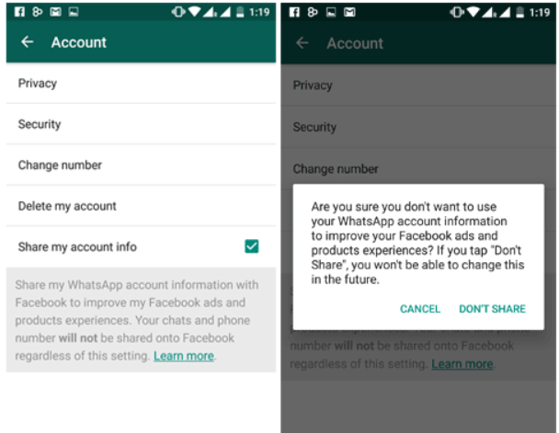
Data Privacy & Protection (Example)
WhatsApp & Facebook
In March 2016, Central Intelligence Agency was able to bypass security enforcement, via malware and hacking tools, to access Whatsapp private encrypted messages
WhatsApp's parent company, Facebook, was revealed to be sharing metadata to improve business experience on Facebook
Threat Type
Malicious
Notes:
Determine what potential threats available + in real world situation

Slide 9
Authentication
Authentication
Authentication refers to the verification and confirmation of one’s identity.
Authentication is extremely important as it allows server to know that:
The client is authorised
The client is who he says he is
Poor or broken authentication allows attackers to exploit potential security flaws, and enables them to spoof as an authorised user.
Notes:
Determine what potential threats available + in real world situation
https://techterms.com/definition/authentication
https://owasp.org/www-project-top-ten/2017/A2_2017-Broken_Authentication
https://owasp.org/www-project-top-ten/
https://blog.eccouncil.org/most-common-cyber-vulnerabilities-part-4-broken-authentication/ (...)

Slide 10

Authentication (Example)
Internal Revenue Service (IRS)
In 2015, the IRS was hacked, resulting in more than 700,000 accounts exposed
The attackers then used the victims data to authenticate themselves to gain even more confidential information such as the transcripts
Notes:
Determine what potential threats available + in real world situation
Authentication problems case studies
https://www.horangi.com/blog/real-life-examples-of-web-vulnerabilities

Slide 11
Security Goals

Slide 12
Confidentiality
Confidentiality
Integrity
Authenticity
Only authorized individuals or systems will be able to view private data within the chat room
The data sent over the network will not be able to be accessed by unauthorized individuals or any third party entities
Cryptographic framework implemented to safeguard data so that even if an attacker gains access to any form of keys, decryption would not be possible
Notes:
Web Application Security Goals Achieved - Confidentiality

Slide 13
Integrity
Confidentiality
Integrity
Authenticity
Ensure that the message received is the actual data that was sent by the authenticated/authorized sender and not by an external third party that could have intercepted it
Methods that ensures the data have not been altered in any way and to provide an assurance that the message received is from the authenticated/authorized sender
Some measures that is implemented to ensure accuracy and completeness of data are: Hash Function, Digital Signatures, and Encrypt-then-MAC
Notes:
Web Application Security Goals Achieved - Integrity

Slide 14
Authenticity
Confidentiality
Integrity
Authenticity
Authenticity within cryptography ensures that the message derives and comes from the intended sender.
Checksums or hashes of message can easily be forged and therefore require schemes to determine the specific entity that the message was originated.
Notes:
Web Application Security Goals Achieved - Availability

Slide 15
Non-repudiation
Non-repudiation guarantees the validity of the message transmitted between parties. This means that the sender will not be able to deny that he is not the one who send the message
As a result, non-repudiation enhances authenticity and integrity of the sent message as the sender’s identity would have been verified
In our program, Cryptochat, Digital signatures and Recipient IDs are utilised to provide as well as serve as an assurance and proof of delivery, ensuring non-repudiation between entities
Notes:
Web Application Security Goals Achieved - Non-repudiation
https://www.cryptomathic.com/products/authentication-signing/digital-signatures-faqs/what-is-non-repudiation

Slide 16
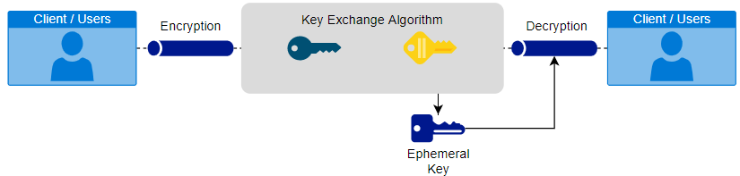
Perfect Forward Secrecy
Perfect Forward Secrecy (PFS) is a concept whereby a breach in a single key exchange would only affect the compromised session and prevent any previous or future exploits
In the encryption framework, forward secrecy aims to enable unique session keys for every initiated session
Implementing with keys that are entirely private and used for short-term exchanges (Ephemeral)
Notes:
Web Application Security Goals Achieved - Perfect Forward Secrecy

Slide 17
Design

Slide 18
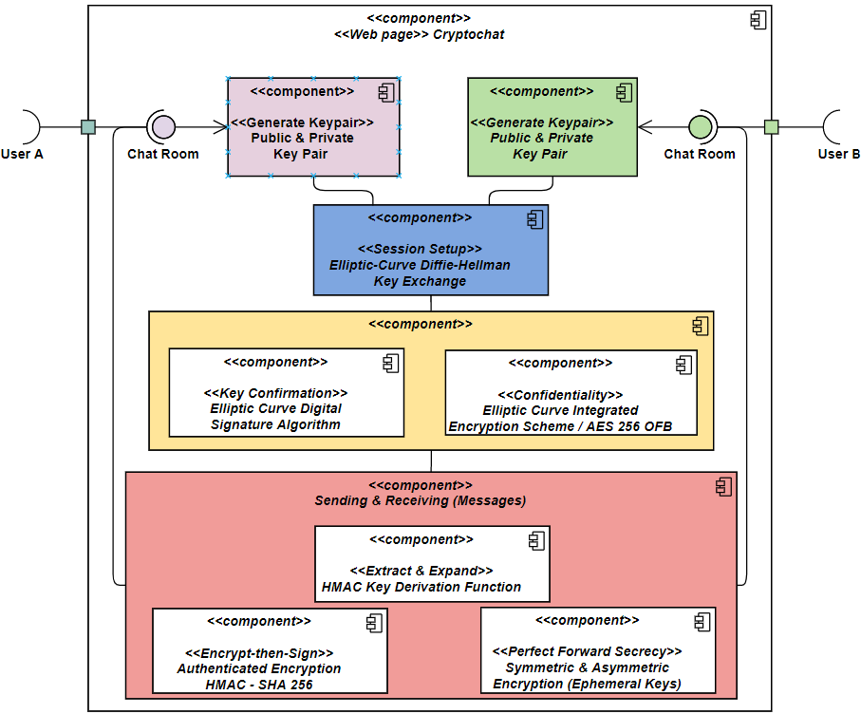
Architectural Diagram (Web Page Component)
Cryptochat: A Web Chat Application
The figure consists of a breakdown of the actual system and develops into a visualized view of each component, and models the static implementation of the system
Notes:
Architectural Diagram of Program

Slide 19
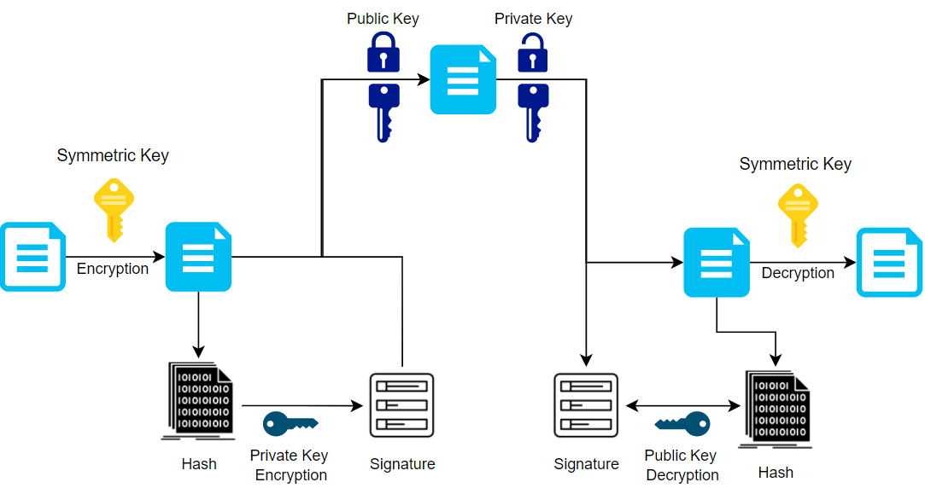
Architectural Diagram (Message Exchange)
Cryptochat: A Web Chat Application
The main function of the Web Chat Application is to provide a End-to-end Encryption communication channel that serves all security goals as defined in the slides <> to <>
Notes:
Architectural Diagram of Program

Slide 20
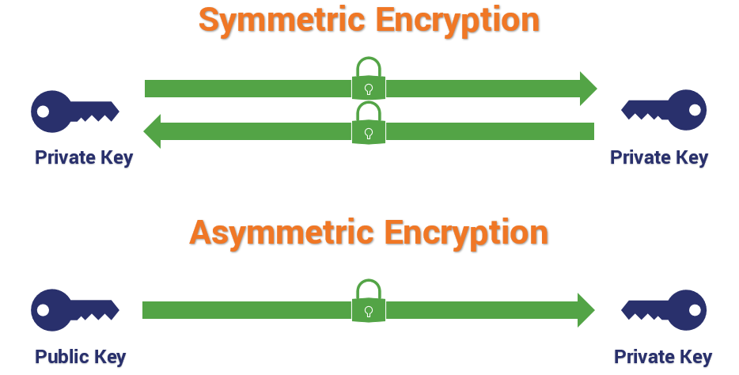
Hybrid Cryptography
Hybrid Cryptography
Common hybrid cryptography uses asymmetric keys to send symmetric keys and other contents to recipients and uses symmetric encryption for messages to achieve faster speed
In this case, Cryptochat’s modified cryptographic scheme offers higher security sacrificing speed by encrypting the symmetric ciphertext with asymmetric encryption
Notes:
Web Application Security Goals Achieved via Key Derivation Function and HMAC, Components of what and why it was used

Slide 21
Multiple Encryption
Multiple encryption
Cascading the encryption offers twice the security but is twice as slow. It slows down the time taken for an attacker to perform a brute force attack
1st symmetric encryption uses a key that changes every round trip with a Salt value of 32 bytes which is almost similar to inserting a 32-character password as input entropy every message exchange (AES-OFB)
Similarly, during the 2nd asymmetric encryption, only the recipient holds the private key required to decrypt the message. Therefore, it is computationally infeasible to derive the private key value used for decryption (ECIES)
Notes:
Web Application Security Goals Achieved via Key Derivation Function and HMAC, Components of what and why it was used

Slide 22
Authenticated Encryption
Authenticated Encryption (AE) with Associated Data
A form of encryption which simultaneously assure the confidentiality and authenticity of data.
The approach adopted is:
Encrypt-then-Mac (EtM) with HMAC - SHA 256
The plaintext is first encrypted, then a MAC is produced based on the resulting ciphertext. The MAC is unforgettable given that the input entropy is generated with the shared secret from ECDH key exchange.
This is semantically secure because the cryptographic algorithm uses asymmetric encryption, generates a random IV and does not reuse them for symmetric encryption
Notes:
Web Application Security Goals Achieved via Key Derivation Function and HMAC, Components of what and why it was used

Slide 23
Protocol / Schemes

Slide 24
ECDH
(Secure Key Exchange)
Elliptic-Curve Diffie–Hellman
A key agreement protocol that allows two parties, each having an Elliptic-Curve Public and Private key pair, also known as cryptography algorithm Secp256k1, to establish a shared secret key
This is specially used by Cryptochat to enable a secure key exchange, that takes place to establish the mutual session key setup. Both parties will establish a secret key value by sending only the public key of their ephemeral key pair
This provides a standard framework for a secure and efficient cryptography for the required Elliptic Curve Domain Parameters and used together with ECDSA in Cryptochat
Notes:
Keep
Gg idk if it’s a bit too long, i might have to edit again
E(S(H(ss + id))) for establishing initial session room id and shared secret k is not being sent over because the other party should know
E(E(m), S(H(E(m) + id)))
If signature verification failed, both parties will generate a private public key pair each and redirect to a new separate room
In this program ECDSA is used in the establishment of initial session, and also when message is sent and received.

Slide 25
ECdsa
(Authenticity & Non-repudiation)
Elliptic Curve Digital Signature Algorithm
ECdsa using secp256k1 is a cryptography algorithm used to sign a piece of data from the sender. This verifies the authenticity of the sender that sends that data. The digital signatures also makes it difficult for users to deny sending the message, resulting in non-repudiation.
During key confirmation, shared secret from ECDH is appended with the room ID and then hashed. The hash is signed with sender’s private key using ECdsa before being encrypted and sent to the receiver. The receiver then verifies the signature with sender’s public key to ensure sender's identity vice versa, for mutual authentication.
During message exchange, ECdsa signs the hash value of the encrypted message appended with the user ID. Afterwhich, it is encrypted together with the symmetric encrypted message before sending to the recipient.
Notes:
Keep
Gg idk if it’s a bit too long, i might have to edit again
E(S(H(ss + id))) for establishing initial session room id and shared secret k is not being sent over because the other party should know
E(E(m), S(H(E(m) + id)))
If signature verification failed, both parties will generate a private public key pair each and redirect to a new separate room
In this program ECDSA is used in the establishment of initial session, and also when message is sent and received.

Slide 26

ECdsa
(Authenticity & Non-repudiation)
Sign (ECdsa-sign)
Pad content to fixed size
Signs contents that is required to be sent over with sender’s private key (sPrK)
Only sender holds the private key, content signed cannot be refute
Let SC = Signed Content
SC = ECdsa(pad(content), sPrK)
Verify Signature (ECdsa-verify)
Verify the signature with the content and sender’s public key (sPK)
verify = ECdsa(SC, sPK)
Notes:
Keep
Might have to change formula?

Slide 27
ECIES
(Confidentiality)
Confidentiality via ECIES-scheme
Cryptochat uses Asymmetric Encryption based off a trapdoor function characteristic, by creating values that is easy to produce in one direction but difficult to be reversed
It is implemented based off a hybrid encryption scheme standardized under crypto standards (ECIES) - SECG SEC-1, ISO/IEC 18033-2, IEEE 1363a and ANSI X9.63
It produces an ephemeral key that will perform ECDH to generate the shared secret with recipient public key which will use different components of the shared secret K to perform an AES-CBC encryption. Even though it seems to be using a symmetric encryption, on a higher level, the recipient private key is still required to decrypt the message with the ephemeral public key, therefore compromising speed while offering higher security with PKI.
Notes:
Web Application Security Goals Achieved via Chosen Asymmetric Encryption ECIES Scheme, Components of what and how it was used

Slide 28
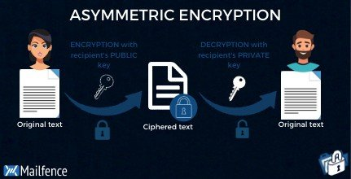
ECIES
(Confidentiality)
Asymmetric Encryption (ECIES)
Generate ephemeral public/private keys (ePK, ePrK)
Encrypt other contents that is required to be sent over with receiver’s public key (rPK)
Let CT = Ciphertext
CT = ECIES-E (content, rPK, ePrK)
Asymmetric Decryption (ECIES)
Uses ephemeral public key (ePK) and receiver’s private key (rPrK) to decrypt content
Content = ECIES-D (CT, rPrK, ePK)
Notes:
Keep

Slide 29
AES-OFB
(Confidentiality)
Symmetric Encryption in Cryptochat
End-to-End Encryption
Enable encryption that occurs across the source and destination
Confidentiality over header and user data
Shared keys
Provide a degree of user authentication security
AES 256 Output Feedback (OFB) Mode
Cryptography confidentiality mode of operation
Lack of interdependence also means that the algorithm is tolerant to the loss in data blocks
recursively encrypted IV, nonce
Notes:
Web Application Security Goals Achieved via Chosen Symmetric Encryption + AES 256 OFB Mode, Components of what and how it was used

Slide 30

AES-OFB
(Confidentiality)
Symmetric Encryption (AES-OFB)
Encrypt message with SK and IV (PRNG)
Let CT = Ciphertext,
CT = AES-OFB-E (message, SK, IV)
Symmetric Decryption (AES-OFB)
Decrypt message with SK and IV
message = AES-OFB-D (CT, SK, IV)
Notes:
Keep

Slide 31
HMAC-SHA256
(Integrity)
Message Integrity
Cryptochat enforces Hash-based Message Authentication Code (HMAC) using the SHA256 hash function after the 1st symmetric encryption, appended with the recipient ID to ensure message integrity and prevent replay attack
Similar to digital signatures where:​
both enforce integrity
both use cryptographic keys
both employ hash functions
Notes:
Keep

Slide 32
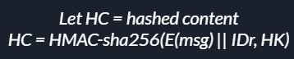

HMAC-SHA256
(Integrity & Authenticity)
Hashing - HMAC-sha256
Passes the Hash key (HK) with content
Uses Encrypt-then-MAC (EtM)
Appended recipient ID with Encrypted Message to prevent replay/interleaving attack
Notes:
Hash key provides authenticity

Slide 33
CSPRNG
(Key generation)
Key Generation
Cryptochat uses the node.js library crypto.randomBytes(size) to generate a cryptographically secure key use for encryption/decryption.
Unless using a hardware number number generator, the pseudo-random number generator will take in the seed value from OS-specific source (/dev/urandom for Unix, and BCryptgenrandom for windows) to generate a cryptographically secured number that presumes security by providing backtracking and prediction resistance.
Bcryptgenrandom passes the NIST 800-22 special publication for statistical randomness test and an attacker should not be able to predict future values based on only observing the entropy source.
Notes:
Keep
Might have to change formula?

Slide 34
HKDF
(Key Derivation)
HMAC Key Derivation Function
Defined in RFC 5869 and introduces Key Derivation Function, Irreversible & Collision Resistant Hash Keys, and Message Authenticity & Integrity to Cryptochat via two modules:
Takes IKM and “extracts” from fixed length PRK (K)
Using HMAC Hash Function (HMAC SHA256)
Optional Salt, as a key
“Expands” key K into several PRK or OKM
Appending PRK-Keyed Hash-Blocks into OKM until desired length
Cryptographically strong OKM of desired length achieved
This ensures the key are uniformly distributed and can be used for encryption/decryption
Notes:
Web Application Security Goals Achieved via Key Derivation Function and HMAC, Components of what and why it was used

Slide 35


HKDF
(Key Derivation)
Extract-and-Expand Paradigm Implementation
Uses HKDF that takes in a different PRNG 32-bytes input entropy every message round trip to generate secret keys for symmetric encryption
Generate hash key for HMAC-sha256 to produce hash
Notes:
Keep

Slide 36
Perfect Forward Secrecy
What is it?
Decrypting current ciphertext will not reveal previous messages
How?
Symmetric Encryption
Generation of secret keys include a Salt that will never be reused every message round trip
Ensures that every message is decrypted with a different secret key
Asymmetric Encryption
Generate ephemeral keys (one-time keys) that will be discarded upon usage every message roundtrip
Ephemeral keys are never reused
Notes:
Keep

Slide 37
Known Attacks

Slide 38
Known Attacks:
Known Plaintext attack
What is it?
Attacker knows a set of plaintext and ciphertext tries every possible key (Bruteforce)
Prevention
As Cryptochat uses 256-bit AES encryption, it is virtually impenetrable to brute force since no computing technology on earth currently can crack it in any reasonable timeframe. Even with the fastest supercomputer in the world, it will take billions of years to crack 256-bit AES encryption
Notes:
Keep

Slide 39
Known Attacks:
Replay Attacks
What is it?
Attacker captures encrypted messages from sender and sends it to receiver, spoofing as the original sender
Prevention
To prevent replay attacks, recipient ID is appended to the encrypted message before being hashed and signed. Therefore, even if the attacker forward the message to another user, the 3rd recipient receiving the message will be able to verify if the signature with the hash appended with intended recipient ID
Notes:
Keep

Slide 40
Known Attacks:
Man-in-the-Middle
What is it?
Attacker can either eavesdrop by a sniffing attack or spoof as a “legitimate” user by performing a key exchange process in the middle to forward message between two legitimate user
Prevention
During initial session establishment, MitM is prevented as room ID is appended to the shared secret before hashing and then signed. As only the users know the room ID, the attacker would fail the mutual authentication since he would not be able to generate the correct hash and validate the signature
In addition, the AES-OFB is used to encrypt the message. Should MitM be able to intercepts the encrypted message. He will not be able to read it as it will be computationally infeasible to decrypt it
Notes:
Keep

Slide 41
Known Attacks:
Cipher-only Attacks
What is it?
Using a number of encrypted messages, attacker tries to recover as much plaintext messages and guess the secret key to decrypt the other messages
Prevention
Attackers often uses statistical techniques such as frequency analysis to attack ciphertext. It is prevented since Cryptochat is encrypted with symmetric (AES 256-OFB) which prevents repeated blocks
It is further encrypted using asymmetric (ECIES) encryption so attacker would not be able to decipher even if a set of ciphertext are known. Similarly, the ephemeral keys, one time use Salt and IV makes frequency analysis harder to identify patterns
Notes:
Keep

Slide 42
Known Attacks:
Chosen-Ciphertext attack
What is it?
Attacker tricks the legitimate user to decrypt the message and sends the message to itself
Prevention
The authenticated encryption mode allows for symmetric encryption then produces a message authentication code (MAC) for the legitimate user to check before decrypting the message, which in this case, Cryptochat is using HMAC-sha256 and a secret shared hash key
Notes:
Keep
ecies ayym key encryp imposible to break private key
aes ofb how prevent known plaintext text 256
perfect forward secrecy

Slide 43
Detailed Program Flow

Slide 44
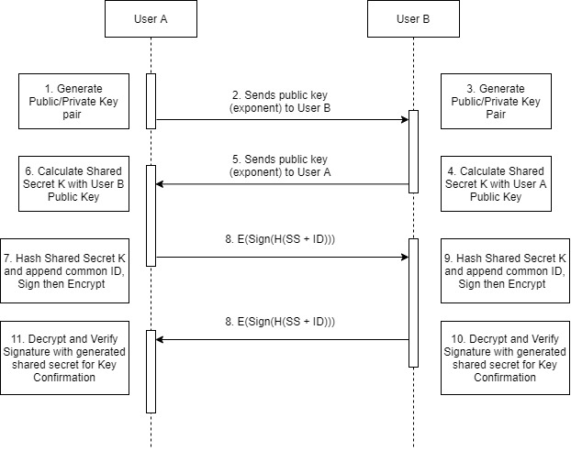
Initial Session Establish
Session Key establishment
Both user exchange public key exponent and calculate shared session secret key K using Elliptic Curve Diffie Hellman (secp256k1)
Notes:
Diagram of program, architectural

Slide 45
Mutual Authentication (Key confirmation)
Mutual Authentication
Key confirmation by hashing key K appended with agreed room ID, sign with sender’s private key and encrypt with recipient public key
Upon receiving message, decrypt and verify signature with own key K appended with agreed room ID
Notes:
Diagram of program, architectural

Slide 46
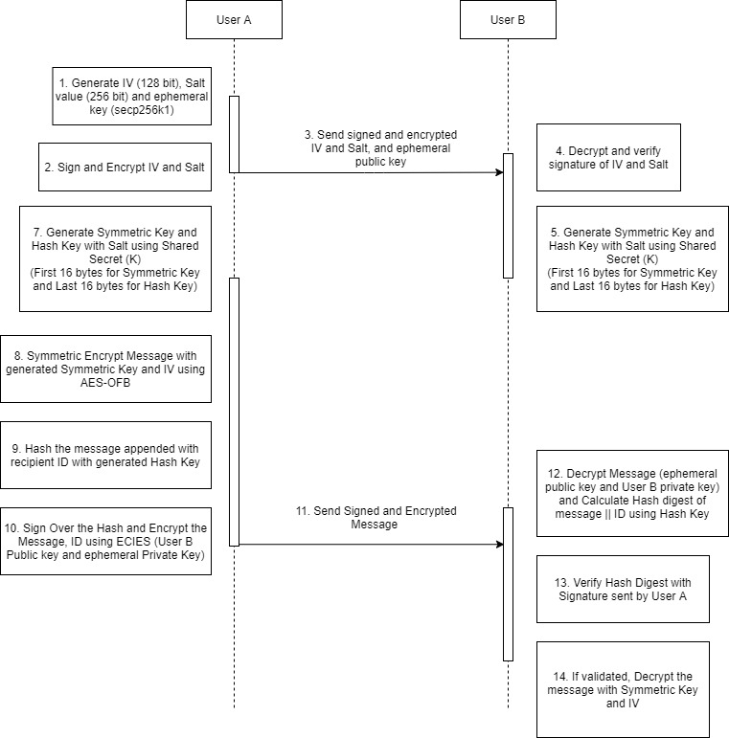
Message Exchange
Sender Generate 128-bit IV, 256-bit Salt and ephemeral key use for symmetric and asymmetric encryption respectively every message round trip
Sign with sender’s public key and encrypt with recipient public key before sending contents
Notes:
Diagram of program, architectural

Slide 47
Message Exchange
Recipient receive, decrypt with private key and validate signature with sender’s public key
Both sender and recipient generate symmetric key and hash key using Salt and IV
Notes:
Diagram of program, architectural

Slide 48
Message Exchange
Sender performs AES-OFB symmetric encryption over message using symmetric key and IV
Sender generates a hash digest of encrypted message appended with recipient ID, H(E(msg) + id)
Sender signs over the hash and encrypt the message, id and hash using ECIES, using recipient public key and ephemeral private key
Notes:
Diagram of program, architectural

Slide 49
Dependencies
Crypto-JS
Futoin-HKDF
Eccrypto Library
AES-JS
Dependencies
Buffer-from
Deasync
Web API Javascript
Notes:
Keep

Slide 50
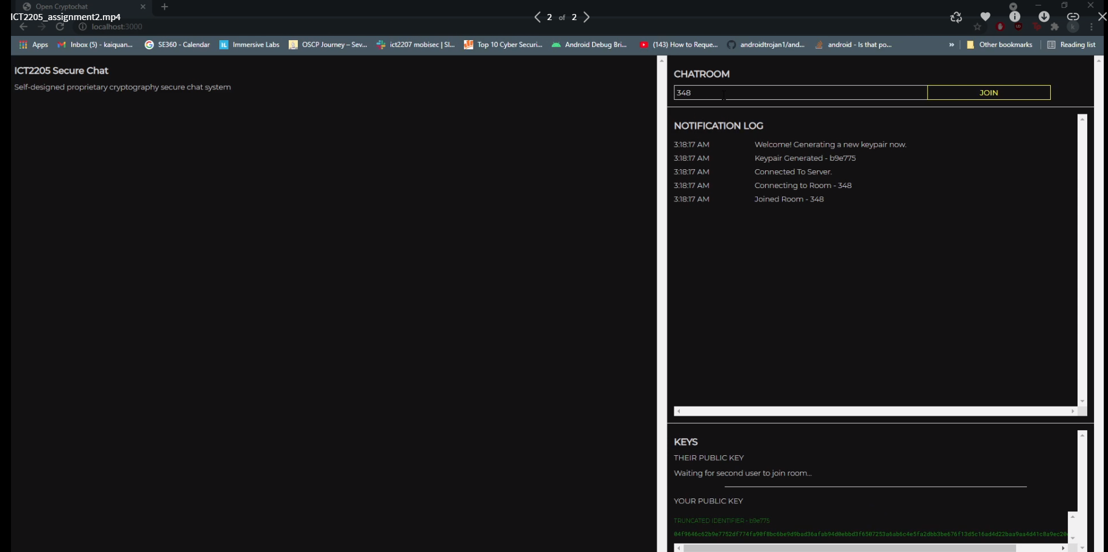
Video Demonstration
Notes:
Video: https://mega.nz/file/SaBzwKpb#qkVVhM2VL8UsproMuNrc8RRdfVs4Fj8364GItZwQgmU
Web Chat Application: https://cryptochatwebapp.azurewebsites.net/

